Slide 1
Using YouTube as an Aid for Adult Learning 2
How I Use Images and Video clips in talks on Big Issues in Science
Allan Wilson GVU3A

Slide 2
Guidelines
This is about video clips, not videos
Enhance a talk, not replace it

Slide 3
Science Topics
The Elements
Climate Change
Evolution of Life on Earth
Key People in Science
Mendeleev
Darwin
Einstein

Slide 4
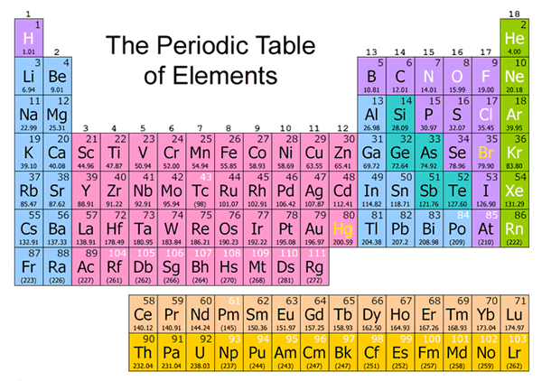
Science can be hard going

Slide 5
About Sodium
In most foods
Common Salt
But what is Sodium as an element?
Hard to demonstrate in a U3A class
Substitute: Demonstration on video from University of Nottingham (also available on You Tube) →

Slide 6
http://www.rsc.org/periodic-table/video/11/Sodium?videoid=7IT2I3LtlNE

Slide 7
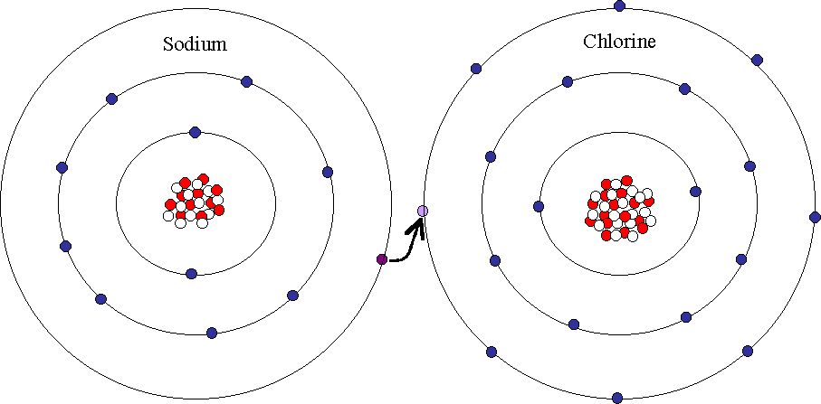
Why is it so?

Slide 8
A light hearted version
www.youtube.com/watch?v=zUDDiWtFtEM

Slide 9
Chubb
Professor Chubb
Chief Scientist for Australia

Slide 10
His Challenge
We have so far pumped two trillion tonnes of a greenhouse gas, CO₂, into our atmosphere since the industrial revolution, at a rate faster than ever before. Why would we presume that it would have no effect?

Slide 11
Global carbon dioxide flux
www.youtube.com/watch?v=t0dXjmoA0dw

Slide 12
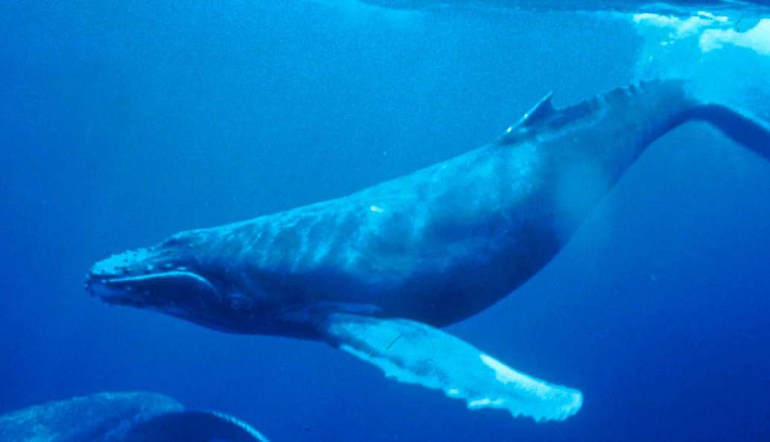
Evolution : Whales
Mammals evolved on dry land
How did they return to the sea?

Slide 13
www.youtube.com/watch?v=8cn0kf8mhS4

Slide 14
Evolution
Use video clips to bring academic specialists into your U3A classroom
Example: ‘Evolution for Everyone’ Professor David Sloan Wilson, University of California Television [57 min]

Slide 15
https://www.youtube.com/watch?v=3yTWnW8t73w

Slide 16
How do I find these video clips?
Internet Search
The periodic table elements video
Global circulation model animation
Continental drift animation
Or search within YouTube itself
Play them through - choose the one that fits your theme – and the audience

Slide 17
What then?
Play them direct from internet
Can be problematic
Embed them in Power Point (1)
Get download helper
Find required video clip
Click on download helper
Download as MP4 file
Go to PPT slide
Insert → video → from file

Slide 18
Embed them in Power Point (2)
Find required video clip
Click on ‘Share’
Click on Embed
Copy the Embed Code
Go to PPT slide
Insert → Video → Video from Website
Paste the copied Embed Code into box
Click on ‘Insert’

Slide 19
Problem solve
Embed method (1) - Need video clip on your flash drive to view embedded video clips
Embed method (2) – Computer must be connected to internet to view embedded video clips
Need newer version of Power point and Windows
Test before you talk

Slide 20
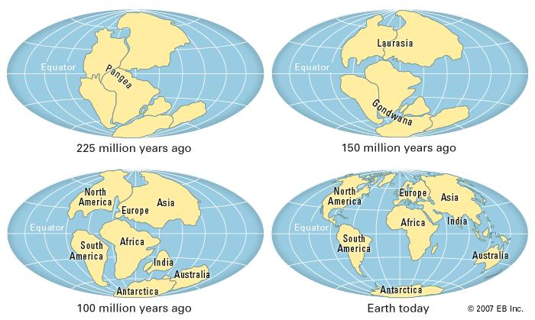
Continental Drift

Slide 21
https://www.youtube.com/watch?v=MEh4B1Pv8YE

Slide 22
Big History
History of the earth and our civilisation
David
Christian
Macquarie
University

Slide 23
European History
Battle of Waterloo re-enactment
https://www.youtube.com/watch?v=lVH28W-cY7E

Slide 24
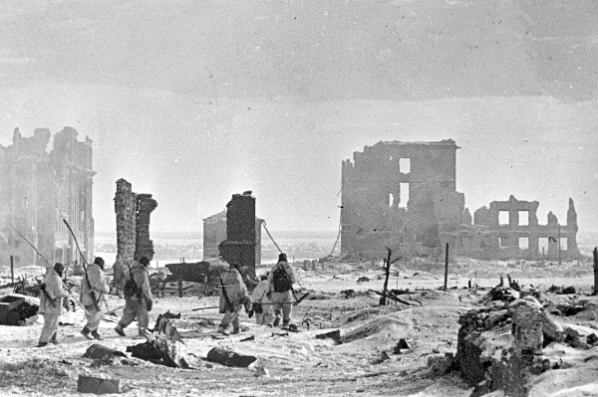
History: The Battle for Stalingrad
Ten or more videos about this epic battle of WW11
https://www.youtube.com/watch?v=49fdHDBJCFI

Slide 25
How To Videos?
How to fix a dripping tap?
www.youtube.com/watch?v=aHXAXM0esa
How to change a tyre?
www.youtube.com/watch?v=joBmbh0AGSQ
How to cook a steak?
www.youtube.com/watch?v=rEx9gPhtjzs
How to speak in public?
www.youtube.com/watch?v=v8tuzZ8k7UU

Slide 26
Video clip Resource
100 best video sites listed at:
http://www.edudemic.com/best-video-sites-for-teachers/
Good videos at:
http://www.howstuffworks.com/videos
http://www.ted.com/
https://www.youtube.com/education
http://www.nasa.gov/multimedia/videogallery/

